Slide 1
Room Scheduling System
Done By:
Mohamed Mohsen
Mohamed Omar
Done For:
Academic
Services

Slide 2
Table Of Content
System Information
Things We Used
Data Flow Diagram
Feasibility
Tangible & Intangible
ERD
Project Progress
Future Plan

Slide 3
System Information
Old System
New System
Users For Both
Difference

Slide 4

Things We Used
Technology
  Java
  Hibernate
Frame Work
  Struts 1.1
Versioning
  Sub Version
Design
  Dream Weaver -Photo Shop -FSCapture

Slide 5
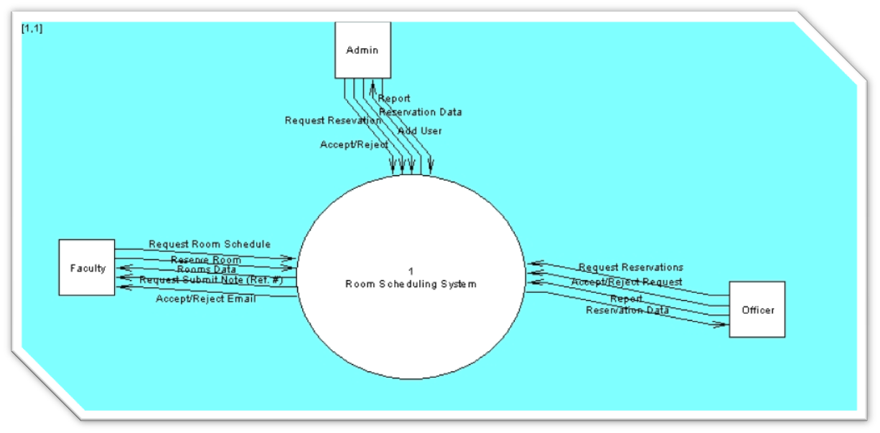
Data Flow Diagram

Slide 6
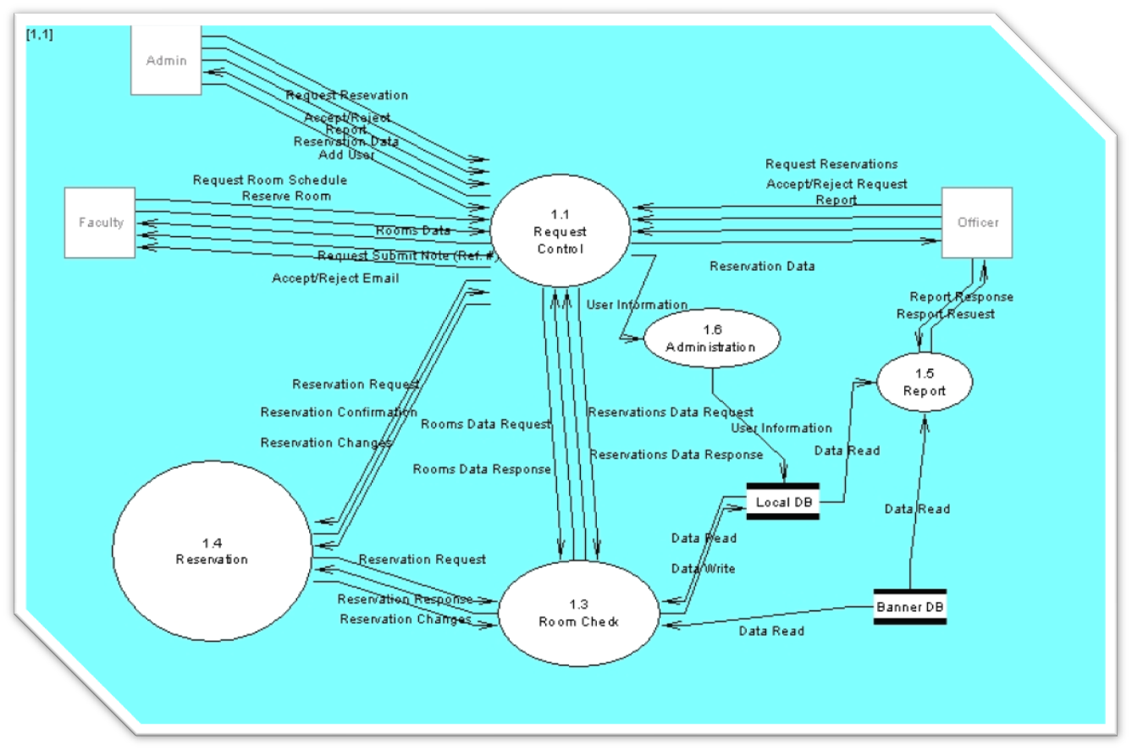
Data Flow Diagram

Slide 7
Feasibility Study
Operational Feasibility
  Faster Process.
Technical
  Using what the college use.
Economical Feasibility
  We Don’t need any money
Scheduling Feasibility
  Enough for basic functions

Slide 8

Tangible & Intangible
Tangible:
  Faster process
  Easier for the users
Intangible:
  Satisfactions between the employees
  Improve the company performance
  More comfortable job

Slide 9
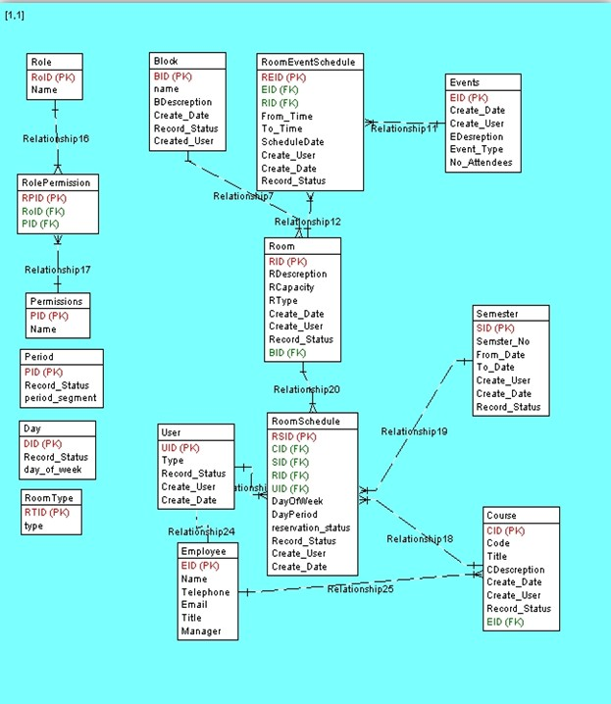
ERD

Slide 10
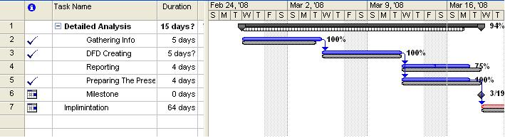
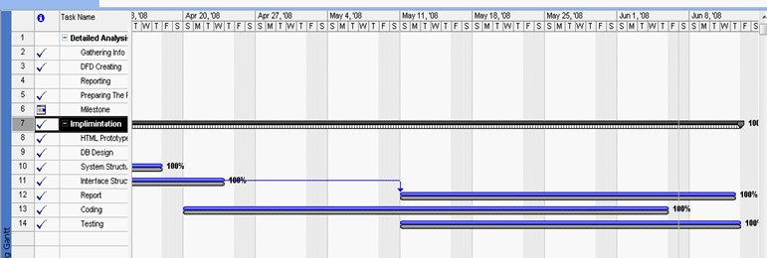
Project Progress

Slide 11
Future Plan
Add Role
Add Room Type
Easy To Improve the Design

Slide 12
Live Demo
Feel Free Trying To Break Our System

